Slide 1
Password Manager
Max Lowther
Notes:
6 Minutes.
Tentative assignments:
1:30 – Application
3:10 – Sprints
0:10 – UML
0:50 – Issues and Challenges
0:20 - Poster

Slide 2
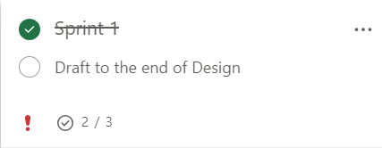
Sprint 1
Timeframe:
20/11/23 – 03/12/23
Objectives:
Research Password Managers (Complete)
Research Encryption Algorithms (Complete)
Draft to end of Design (Incomplete)
Notes:
Show program execution beforehand, maybe talk about “Final Project Plan” as well?
Do NOT spend too long on sprints, they make up the majority of the slides, but aren’t very important

Slide 3
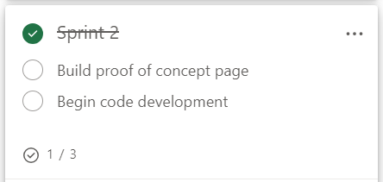
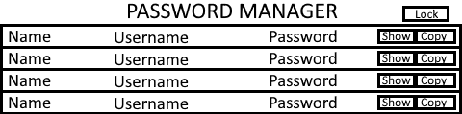
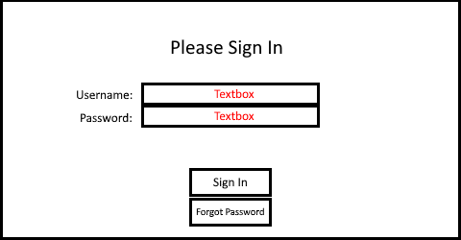
Sprint 2
Timeframe:
04/12/23 – 17/12/23
Objectives:
Design Page (Complete)
Build Proof of Concept Page (Incomplete)
Begin Code Development (Incomplete)
Notes:
Decent progress, not the best

Slide 4
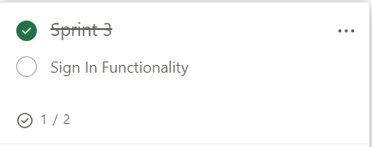
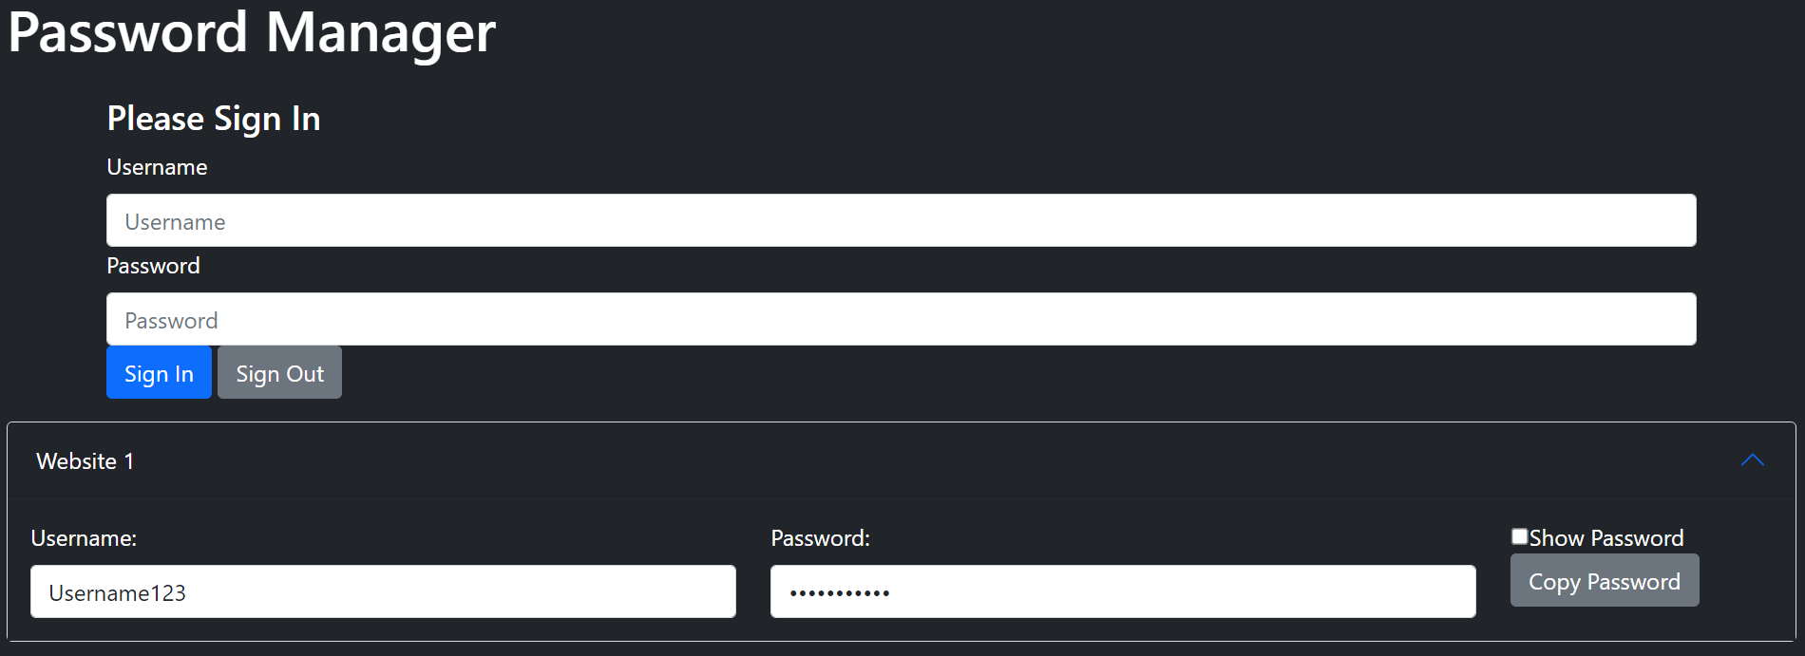
Sprint 3
Timeframe:
18/12/23 – 07/01/24 (Long)
Objectives:
Make Page Draft (Complete)
Add Sign In functionality (Incomplete)
Notes:
Again, decent progress for design

Slide 5
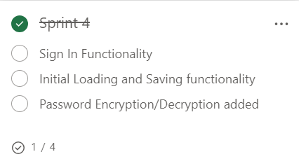
Sprint 4
Timeframe:
08/01/24 – 21/01/24
Objectives:
Add Sign In functionality (incomplete)
Get initial Loading and Saving functional (incomplete)
Password Encryption / Decryption added (incomplete)
Make Video (complete)
Notes:
Bad progress towards the project, but a major submission was completed

Slide 6
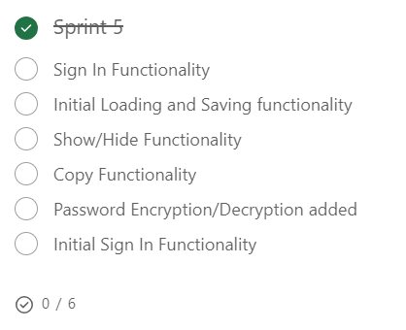
Sprint 5
Timeframe:
22/01/24 – 04/02/24
Objectives:
Add Show/Hide functionality (Incomplete)
Add Copy functionality (Incomplete)
Password Encryption / Decryption Added (Incomplete)
Others
Notes:
Work was done, but no tasks were completed. Overestimated capacity.

Slide 7
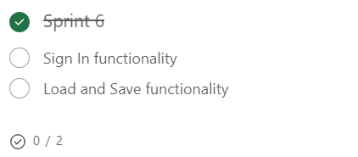
Sprint 6
Timeframe:
05/02/24 – 18/02/24
Objectives:
Add initial Sign In functionality (Incomplete)
Get initial Loading and Saving functional (Incomplete)
Notes:
Little progress made due to JS file management difficulties

Slide 8
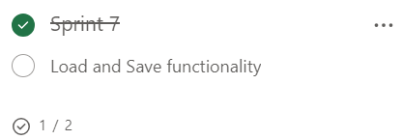
Sprint 7
Timeframe:
19/02/24 – 03/03/24
Objectives:
Add initial Sign In functionality (Complete)
Get initial Loading and Saving functional (Incomplete)
Notes:
Major progress

Slide 9
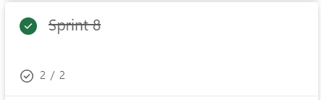
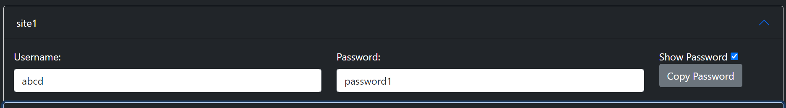
Sprint 8
Timeframe:
04/03/24 – 17/03/24
Objectives:
Add Password Copying (Complete)
Add the Show/Hide function (Complete)
Notes:
Good progress, but on small tasks

Slide 10
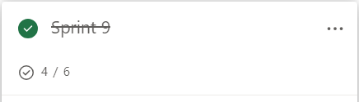
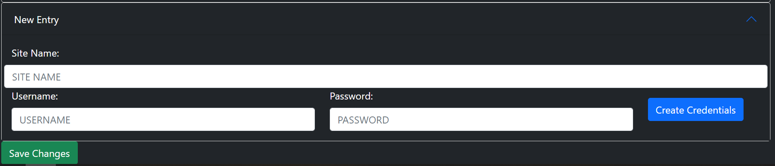
Sprint 9
Timeframe:
18/03/24 – 31/03/24
Objectives:
Add Credential Display functionality (Complete)
Allow for the creation of Credential Display elements (Complete)
Allow for the creation of Credentials (Complete)
Allow for Credential Updates to be Saved (Complete)
Implement Encryption / Decryption / Hashing (Incomplete)
Test (Incomplete)
Notes:
Major progress, leaving just two program-side tests.
At this point, the program was fully functional and usable, but lacked security.

Slide 11
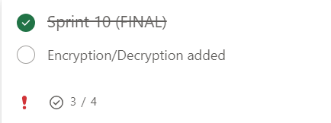
Sprint 10
Timeframe:
01/04/24 – 14/04/24
Objectives:
Hashing Added (Complete)
Encryption / Decryption Added (Incomplete)
UML Diagrams Created (Complete)
Portfolio Finished (Complete)
Notes:
This was the final sprint.
Though Hashing was added, the Encryption and Decryption features were not due to the need to finish the Portfolio taking priority.

Slide 12
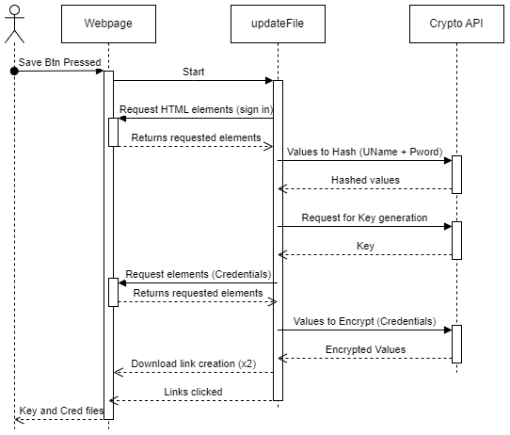
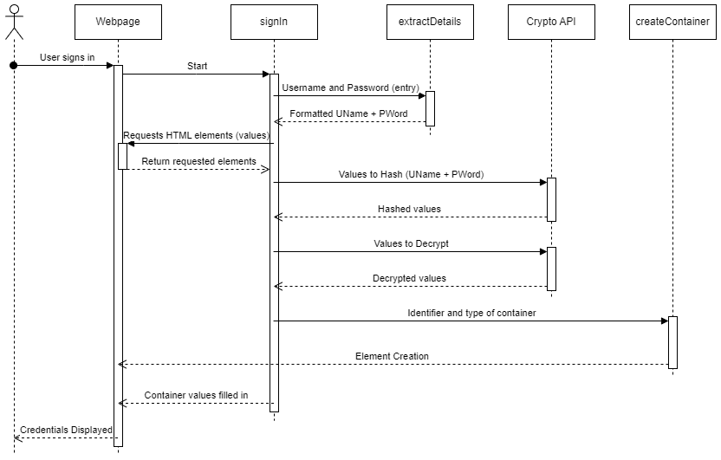
UML Diagrams
Sequence Diagram for Saving
Sequence Diagram for Signing In and Loading
Notes:
Here are the two sequence diagrams created for the Password Manager, the left one represents the Saving process, the right the process of Signing In and Loading

Slide 13
Issues and Challenges Faced
File handling
Difficulties during development
Inability to update files, only upload and download
Cryptography
Issues with the asynchronous nature of the library
Time Management
Ran out of development time, resulting in Encryption and Decryption being dropped

Slide 14
